Slide 1


Introduction to Strings in Python

Slide 2
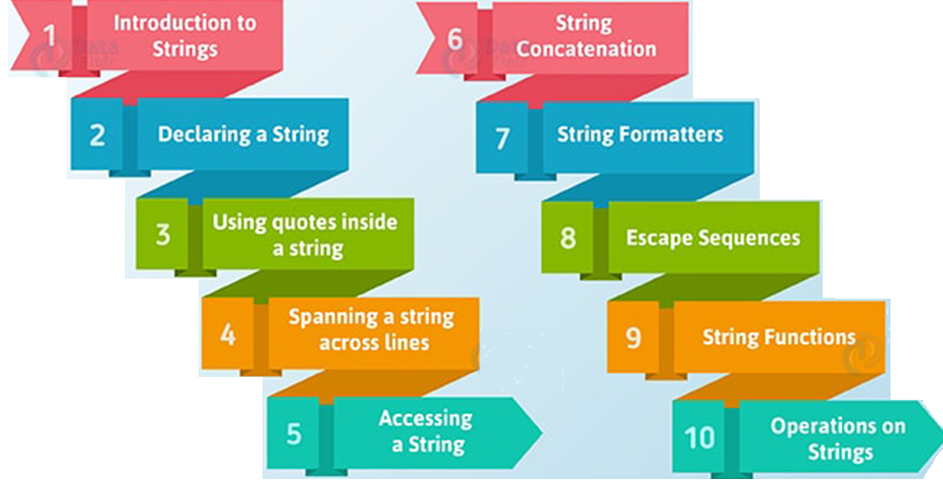

Slide 3

what is string?
One of the most important data type in python
A string is generally considered as a sequence of characters and is often implemented as an array data structure of byte
String may contain alphabet, numbers or special characters
Stores a sequence of elements, typically characters, using some character encoding.
String can be assigned to a variable like a = ‘hello world’
Computer Science Department, UET Lahore.

Slide 4
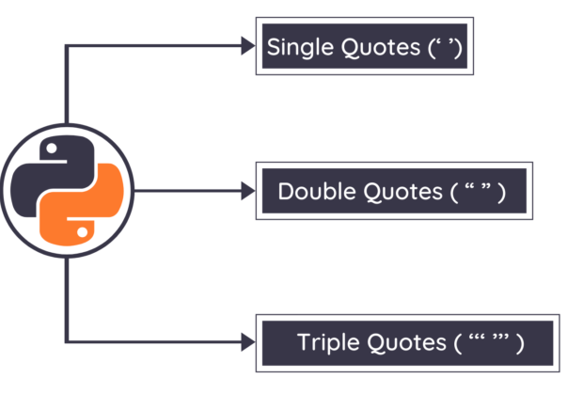

Ways to define a string
Computer Science Department, UET Lahore.

Slide 5
String declaration & Assignment
String can be assigned to a variable like
‘hello world’
“hello world”
a =‘’‘hello world’’’
Computer Science Department, UET Lahore.

Slide 6
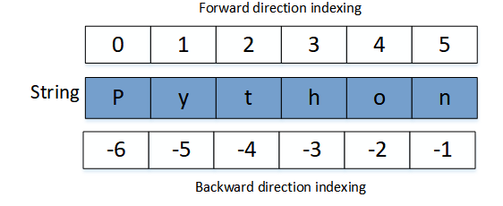


String indexing
Negative Indexing
Positive Indexing
Computer Science Department, UET Lahore.

Slide 7
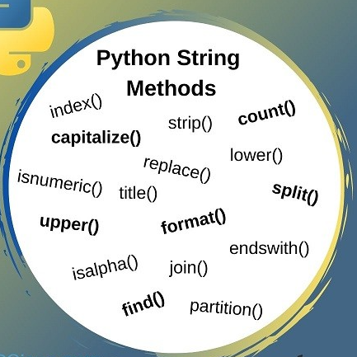
String Methods
Computer Science Department, UET Lahore.

Slide 8
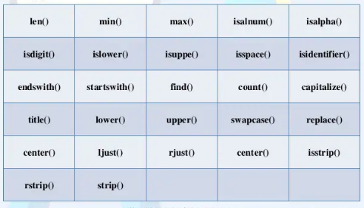
String Functions
Computer Science Department, UET Lahore.

Slide 9
Inbuilt string function
len() : Find the total length of the characters in string
max(): Find Largest value in the string based on ASCII values
min(): Find smallest value in the string based on ASCII values
enumerate(): Returns an enumerated object. It contains the index and value of all the items in the string as pairs. This can be useful for iteration.
Computer Science Department, UET Lahore.

Slide 10
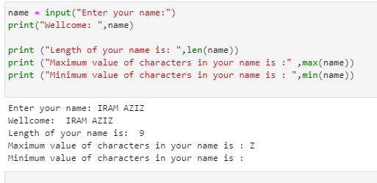
Examples of string functions?
Computer Science Department, UET Lahore.

Slide 11
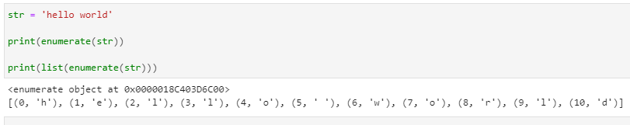
Example for enumerate Functions
Computer Science Department, UET Lahore.
Notes:
Something about high and low level languages.

Slide 12
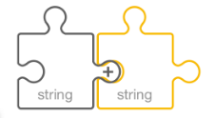
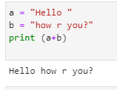
String Concatenation function
The “+” operator is used for string Concatenation
Example:

Slide 13

String Concatenation function & “*” operator

Slide 14

String Slicing
A segment of string is called a slice
Slicing is used to select/return/slice a particular substring based on user requirement
Example:
Syntax : Input_str [strat:end]

Slide 15
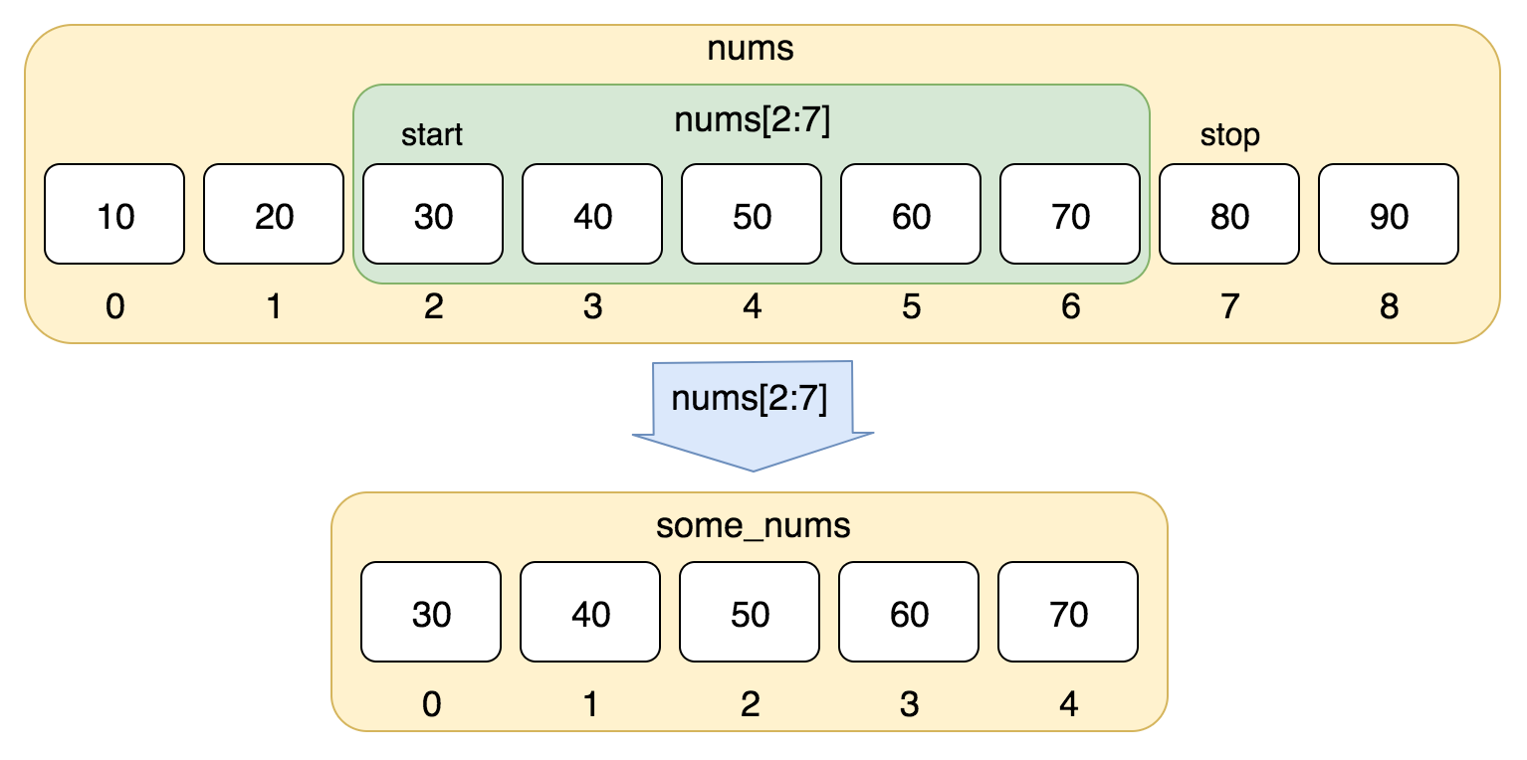
String Slicing

Slide 16
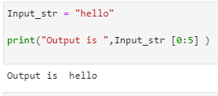

String Slicing

Slide 17
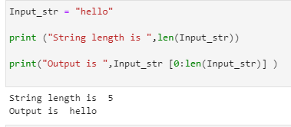
String Slicing

Slide 18
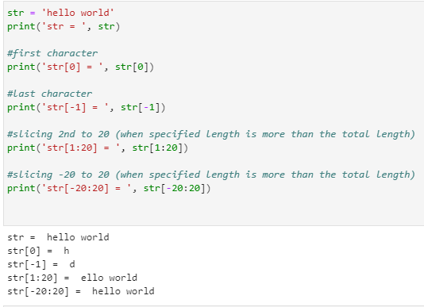
String Slicing when index out of range

Slide 19
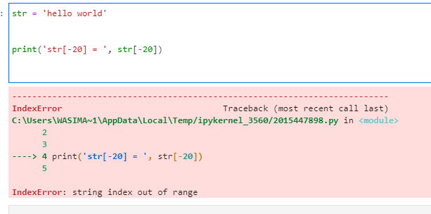
String Slicing when a specific
index out of range

Slide 20
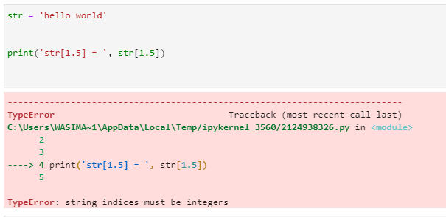
String Slicing when specified
index is not an integer

Slide 21
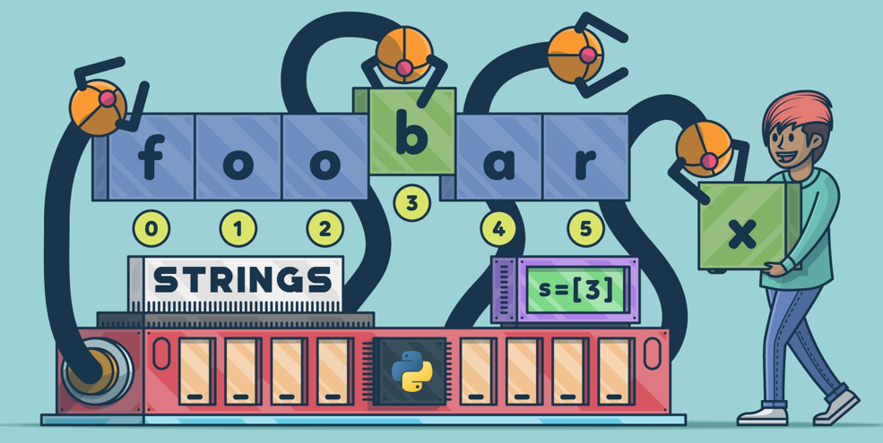
Python String are immutable

Slide 22
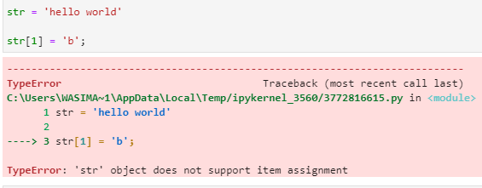
Python String are immutable
Strings are immutable character set.
Once you generate a string you can’t change any character within it

Slide 23
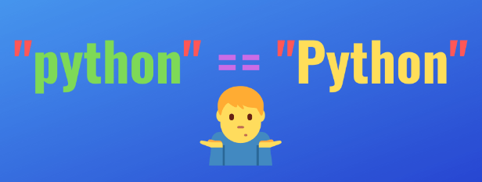
Python String Comperison
We can compare two strings with
comparison operators
such as ==, > , <, !=, =>, =<
Comparisons performed on the base of ASCII values

Slide 24
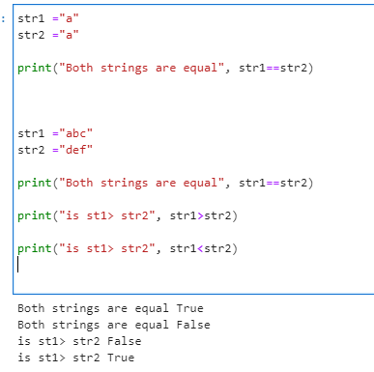
Example: Python String Comperison

Slide 25
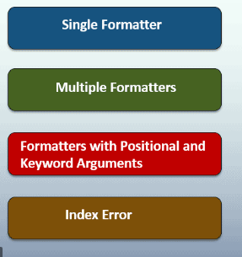
Python String Formatting

Slide 26
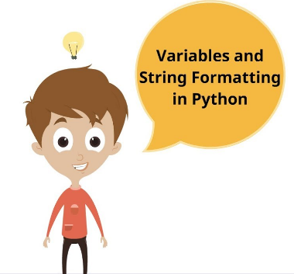
Python String Formatting
“%” used to
format strings

Slide 27
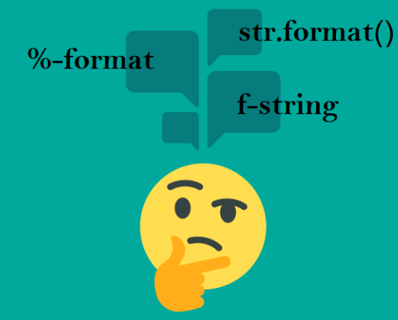

Python String Formating
“%” used to format strings
Example

Slide 28
Other String Functions

Slide 29
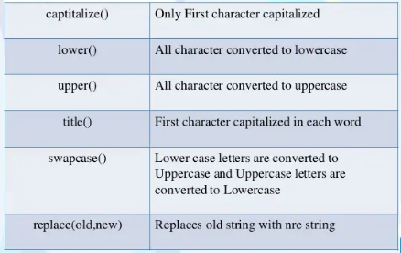
Conversion Functions

Slide 30
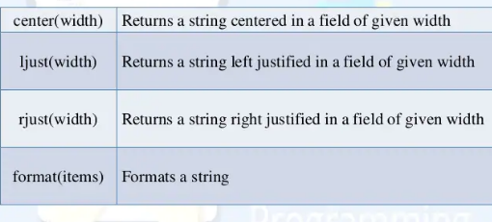
Formatting Functions

Slide 31
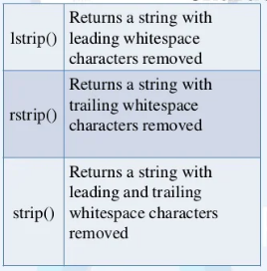
Removing white space characters

Slide 32
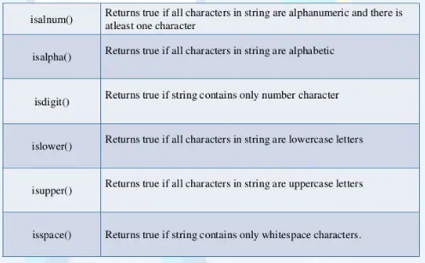
Testing string or character Functions

Slide 33
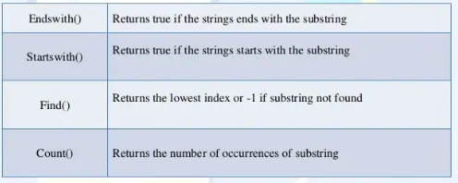
String search Functions

Slide 34

Take Home Tasks
Find the difference between methods and function.
List out all string functions and methods.
Implement all functions and methods with at least one example
Computer Science Department, UET Lahore.

